Slide 1


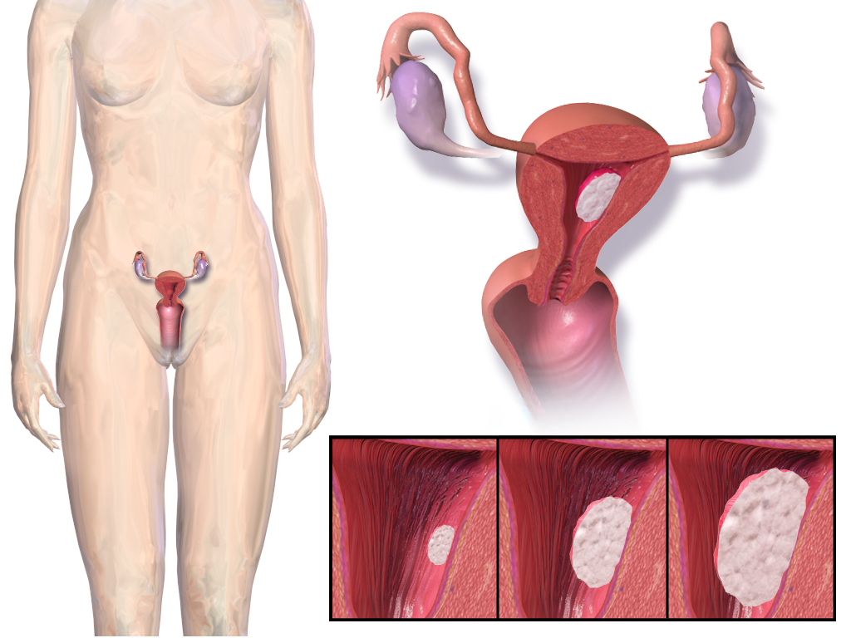
Key Question
What is Menstruation?

Slide 2

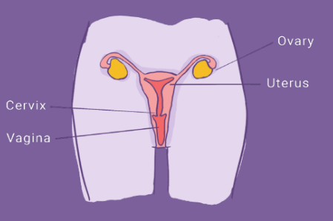
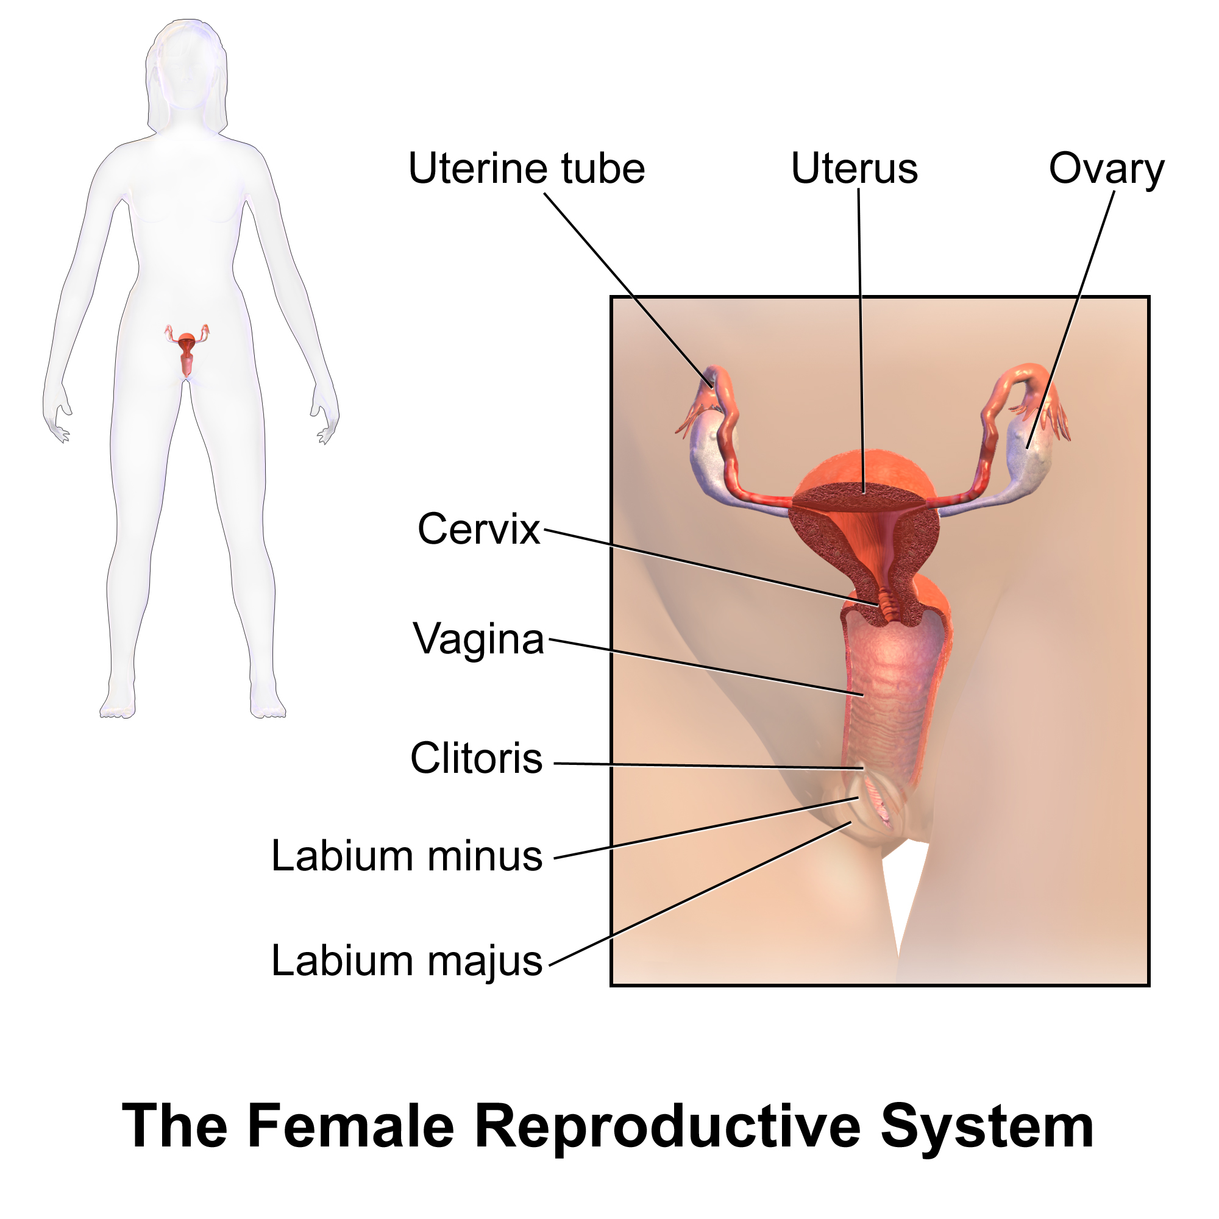
Key Information
Female internal genitalia
ttps://o.quizlet.com/MSo8zVnIg.opbPVToH9WZg_b.png
https://en.wikipedia.org/wiki/Female_reproductive_system

Slide 3

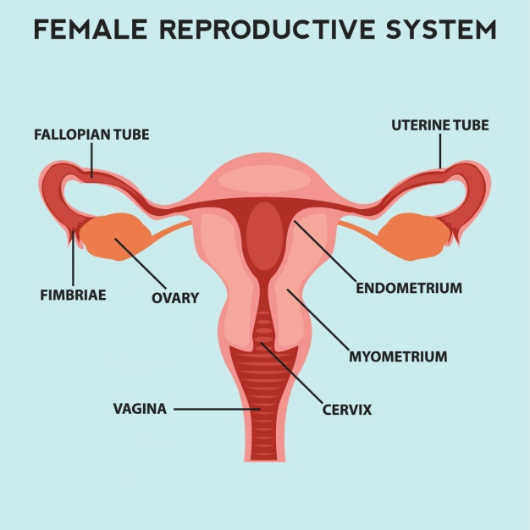

Key Vocabulary
Female internal genitalia
These are the organs in our bodies that allow for us to reproduce
UTERUS
https://www.freepik.com/free-vector/female-reproductive-system_1024250.htm

Slide 4
Key Vocabulary
Ovaries
The organ that produces ova (eggs)
UTERUS
https://www.freepik.com/free-vector/female-reproductive-system_1024250.htm

Slide 5
Key Information
Key Vocabulary
Uterus
The place where a baby can grow
Also known as a womb
UTERUS
https://www.freepik.com/free-vector/female-reproductive-system_1024250.htm

Slide 6
Key Vocabulary
Vagina
The passage, inside the body, that connects the uterus to the vulva (on the outside of the body)
UTERUS
https://www.freepik.com/free-vector/female-reproductive-system_1024250.htm

Slide 7
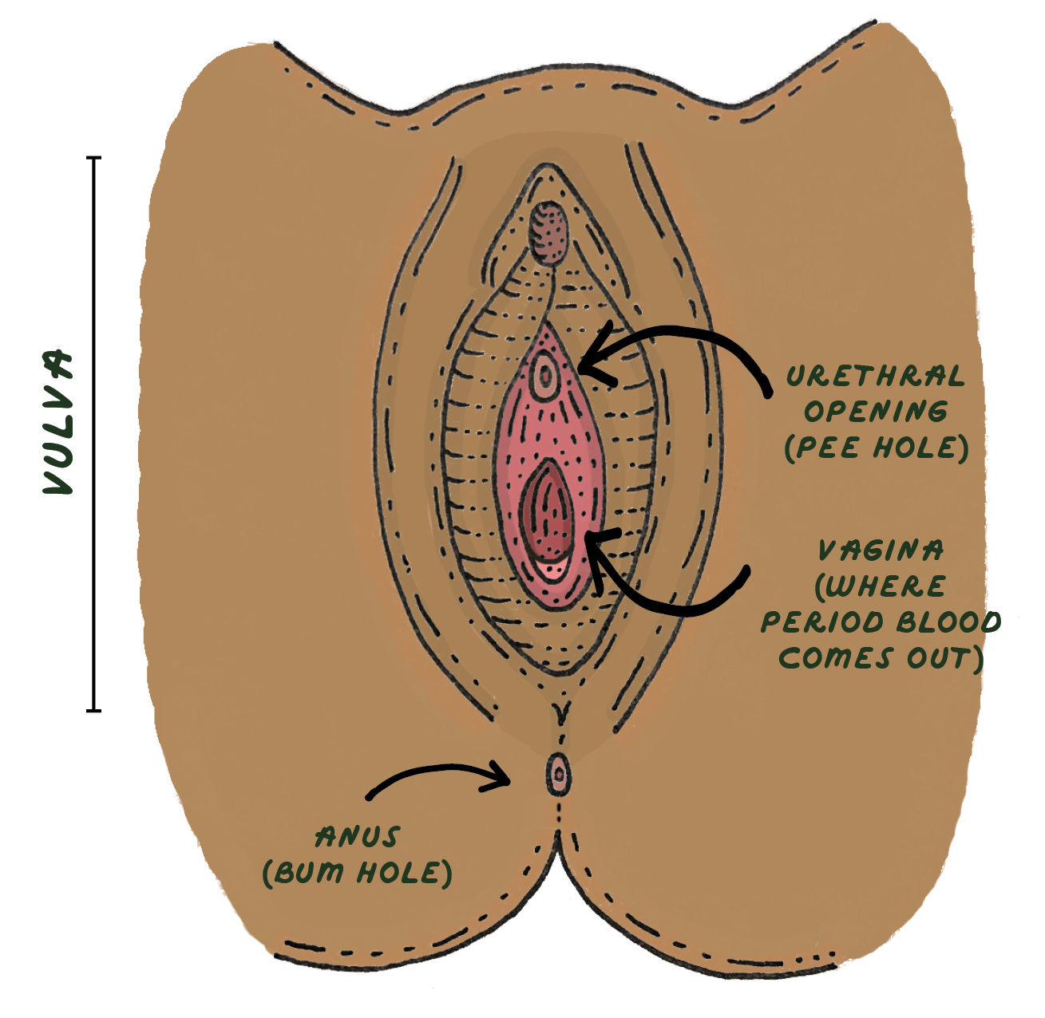
Key Vocabulary
Female external genitalia
The vulva is the area on the outside of the body
It includes the urethral opening (where the pee comes out) and the vagina (where period blood comes out)
https://www.freepik.com/free-vector/female-reproductive-system_1024250.htm

Slide 8
Key Vocabulary
Female external genitalia
The anus (where poo comes out) is further back and not part of the vulva
https://www.freepik.com/free-vector/female-reproductive-system_1024250.htm

Slide 9

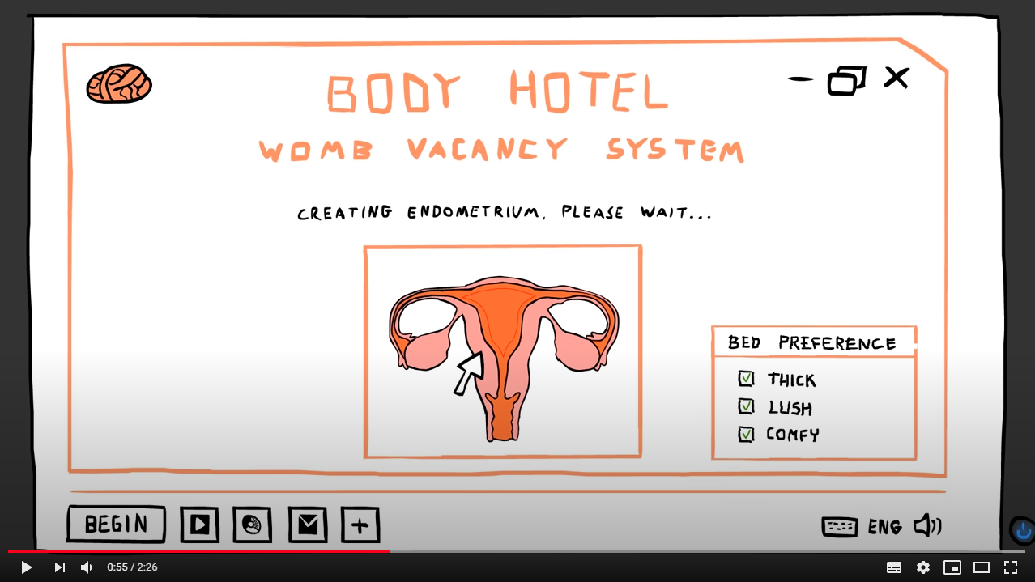
Watch Video
Listen carefully to the video
All About Getting Your Period
https://www.youtube.com/watch?v=RX4NJrJxwss

Slide 10

Quiz time
Let’s see how well you understood that video
Question 1:
Who menstruates?
Answer:
Biological females, once they start puberty
(between the ages of 8 and 18)

Slide 11
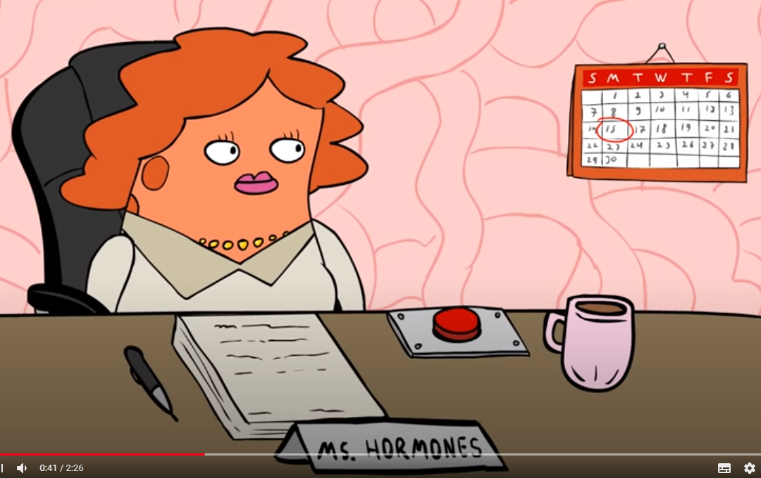
Quiz time
Let’s see how well you understood that video
Question 2:
What causes menstruation (periods) to start?
Answer:
Hormones created during puberty tell your body to get ready to menstruate

Slide 12
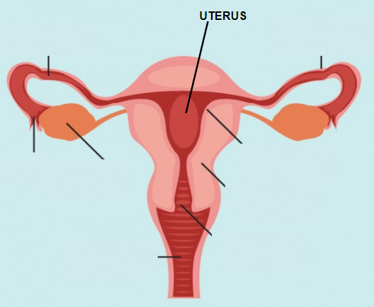
Quiz time
Let’s see how well you understood that video
Question 3:
What is the name of the organ that creates a thick, lush, comfy area, in which a baby could potential grow?
Answer:
The uterus (or womb)

Slide 13
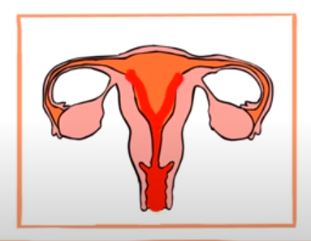
Quiz time
Let’s see how well you understood that video
Question 4:
Where does the blood come from when you menstruate (have your period)
Answer:
The soft lining of the uterus is being renewed, so the old lining must be pushed out first

Slide 14
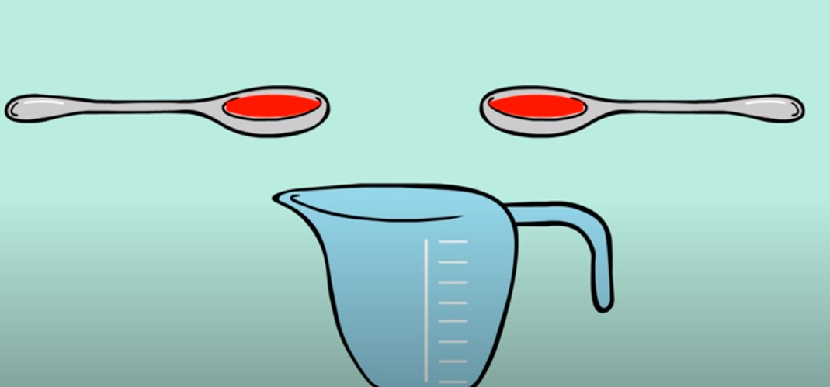
Quiz time
Let’s see how well you understood that video
Question 5:
How much blood comes out when someone menstruates?
Answer:
2 -5 tablespoons
(It may seem like a bit more, as other fluids can come out too)

Slide 15
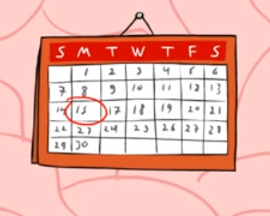
Quiz time
Let’s see how well you understood that video
Question 6:
How often do people menstruate?
Answer:
Roughly once a month, but this varies a lot
It can be longer or shorter than this

Slide 16
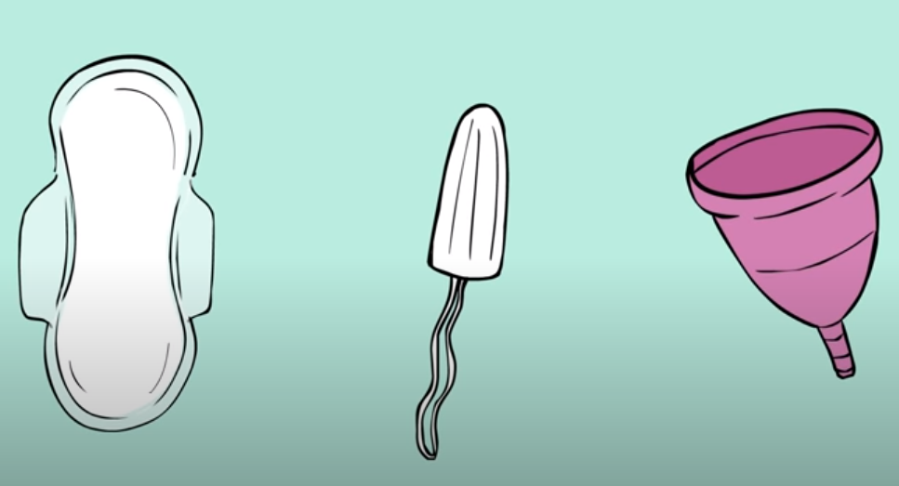
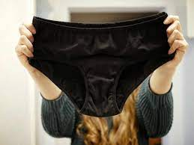
Quiz time
Let’s see how well you understood that video
Question 7:
What can you use to manage a period?
Answer:
- Period pads / sanitary towels
- Tampons
- Menstrual cups
- Period pants

Slide 17
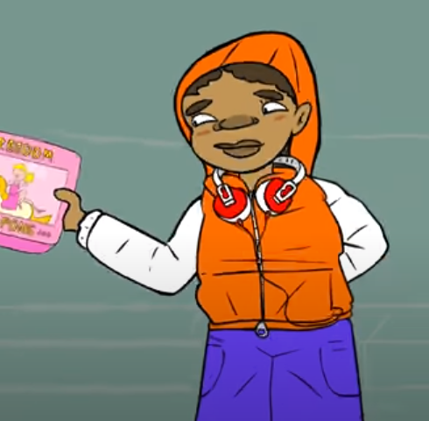
Quiz time
Let’s see how well you understood that video
Question 8:
Are periods painful?
Answer:
Some menstruators experience headaches, stomach aches or cramps (and some don’t)
It might be painful for some
Ask an adult about taking pain relief
(never take medicine without checking with a responsible adult)

Slide 18
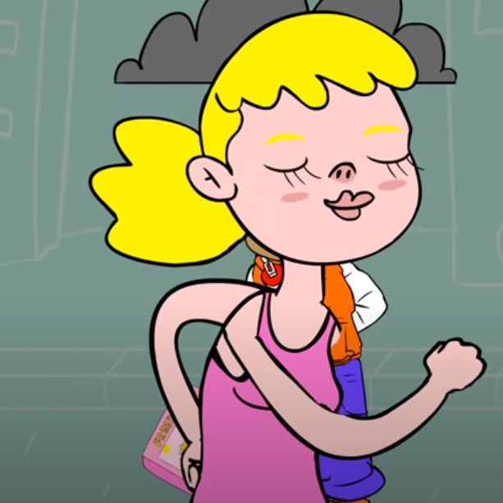
Quiz time
Let’s see how well you understood that video
Question 9:
Can you do anything to reduce the discomfort?
Answer:
Exercise, warm baths and hot water bottles/heat pads help for many people
Sympathy from friends and family are good too!

Slide 19
Key Information
The menstrual cycle
The uterus grows a soft lining, which is where a baby could grow
UTERUS
https://www.freepik.com/free-vector/female-reproductive-system_1024250.htm

Slide 20
Key Information
The menstrual cycle
An ovum (egg) is released from the ovaries
UTERUS
https://www.freepik.com/free-vector/female-reproductive-system_1024250.htm

Slide 21
Key Information
The menstrual cycle
The egg travels to the uterus
It will remain as a tiny egg, unless the menstruator is making a baby*
*you will learn more about how and when eggs turn into babies in other lessons, as decided by your parents and school
UTERUS
https://www.freepik.com/free-vector/female-reproductive-system_1024250.htm

Slide 22
Key Information
The menstrual cycle
The lining of the uterus (blood) travels down from the uterus, through the vagina, where it then leaves the body through the vaginal opening
UTERUS
https://www.freepik.com/free-vector/female-reproductive-system_1024250.htm

Slide 23

Key Information
Menstruation
Almost all biological females go through menstruation
It is nothing to be scared of - it is a sign that your body is healthy
It a natural part of becoming an adult

Slide 24
Key Information
Menstruation
Each time it occurs, it lasts for 3 - 8 days
On average, it is 5 days long

Slide 25

Key Information
Menstruation
Different people start their period at very different times
You can be anywhere between 8 and 18!
(It is most common to start between aged 10 and 16)
It will begin when your body is ready

Slide 26



Key Information
Menopause
Menstruators will continue to have periods until they reach the menopause
This happens between the ages of 40 and 60
It means that you have stopped menstruating

Slide 27

Key Information
Emotions
During the monthly period cycle, menstruators may notice their mood changing

Slide 28
Key Information
Emotions
Some days, they may feel energetic, creative or sociable
Other days they may feel like being alone or relaxing
Sometimes they might feel happier than usual, or they may have negative emotions
(such as feeling down for a few days)

Slide 29
Key Information
Emotions
The experience of changing moods and emotions is unique to everyone - each person experiences the menstrual cycle in their own way
Common feelings include feeling joyful, sensitive, irritable, anxious or sad

Slide 30
Key Information
Emotions
Menstruation can make feelings more heightened at certain times. However, it’s important to remember that EVERYONE experiences emotional changes during puberty, which are affected by hormonal cycles.

Slide 31
Key Information
Emotions
It is important not to ever make fun of someone for having their period
Making jokes about people being ‘moody’, ‘angry’ or ‘irrational’ are sexist, unfair and not based on reliable evidence

Slide 32
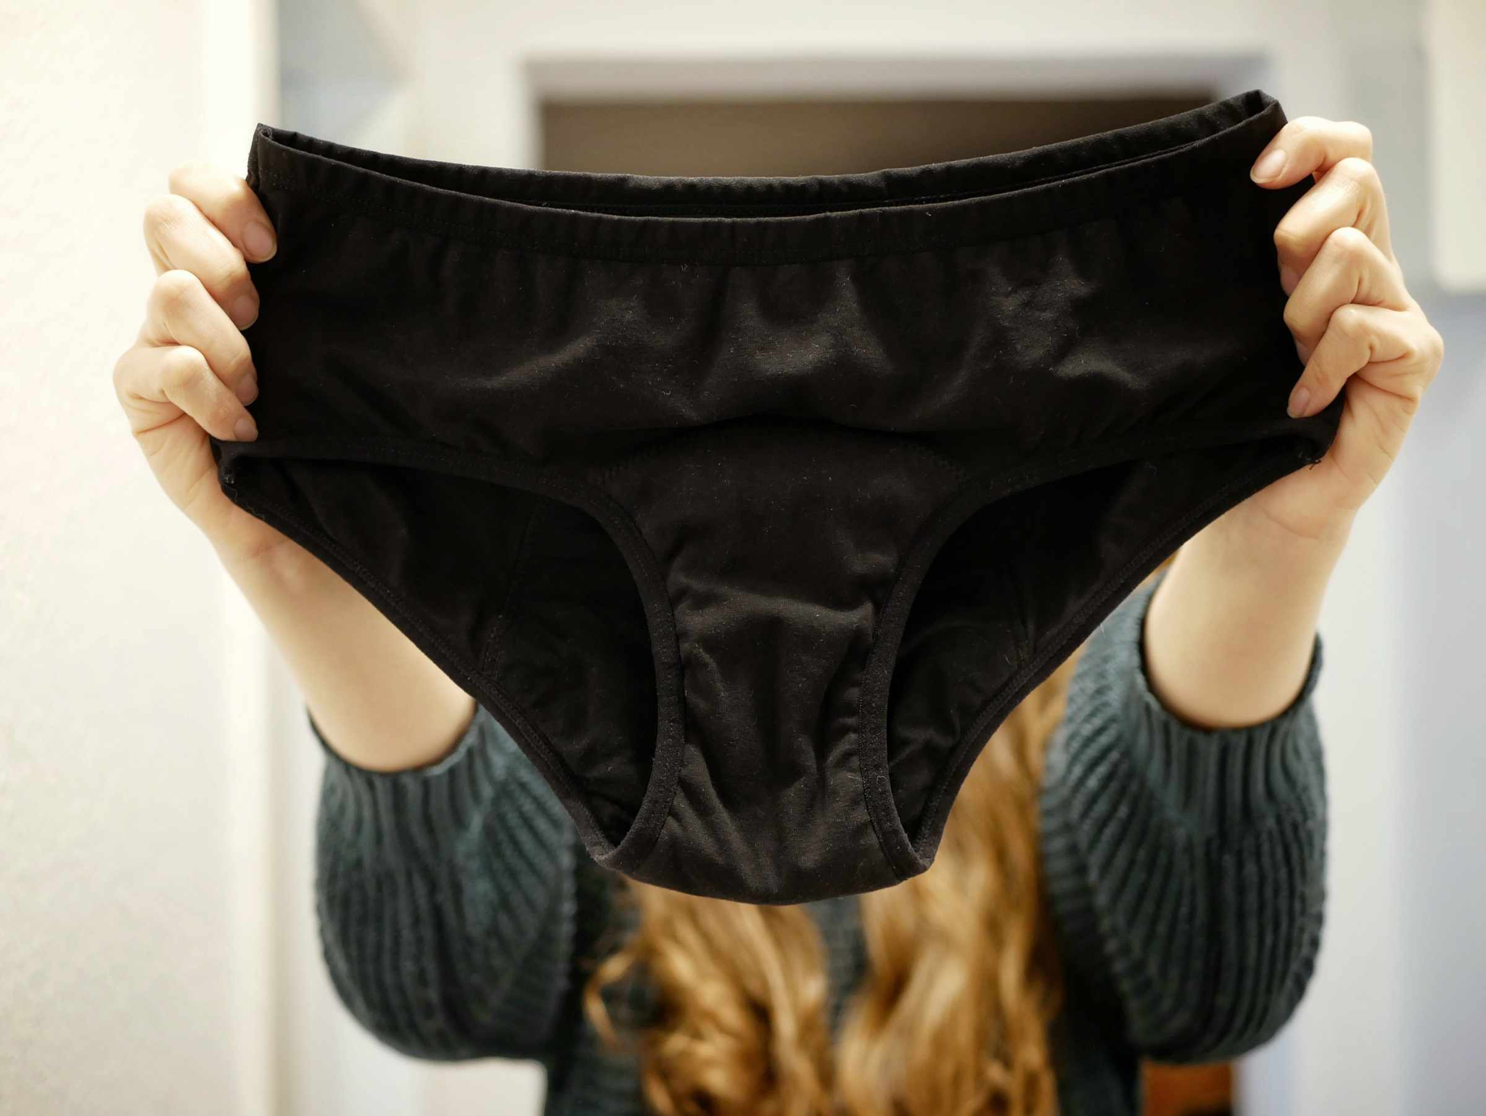
Key Information
Menstruation management
There are various products that can help manage menstrual blood
Each one does a similar thing: catching or absorbing the blood

Slide 33
Key Information
Menstruation management
If blood does get on your clothes, this is not a big deal and it happens to lots of people

Slide 34
Key Information
Menstruation management
If used correctly, it allows menstruators to do the things they want to do, regardless of their menstrual cycle!
It is important to change/empty these products regularly, to avoid infection and be hygienic

Slide 35
Key Information
Menstruation management
Sometimes a white or clear discharge (liquid) comes out of the vagina too
This is also completely normal

Slide 36
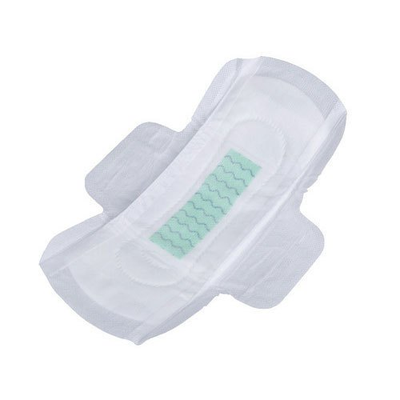
Key Information
Period pads/ sanitary towels
These are used to line the menstruator’s pants
They are absorbent, and soak up any menstrual blood that comes out the vagina

Slide 37
Key Information
Period pads/ sanitary towels
They should be changed regularly, depending on how heavy the period is (2 - 4 times a day)
They are easy to use and so are good for people who have just started to have their period

Slide 38
Key Information
Period pads/ sanitary towels
They have a sticky area, which attaches the pad to your pants

Slide 39
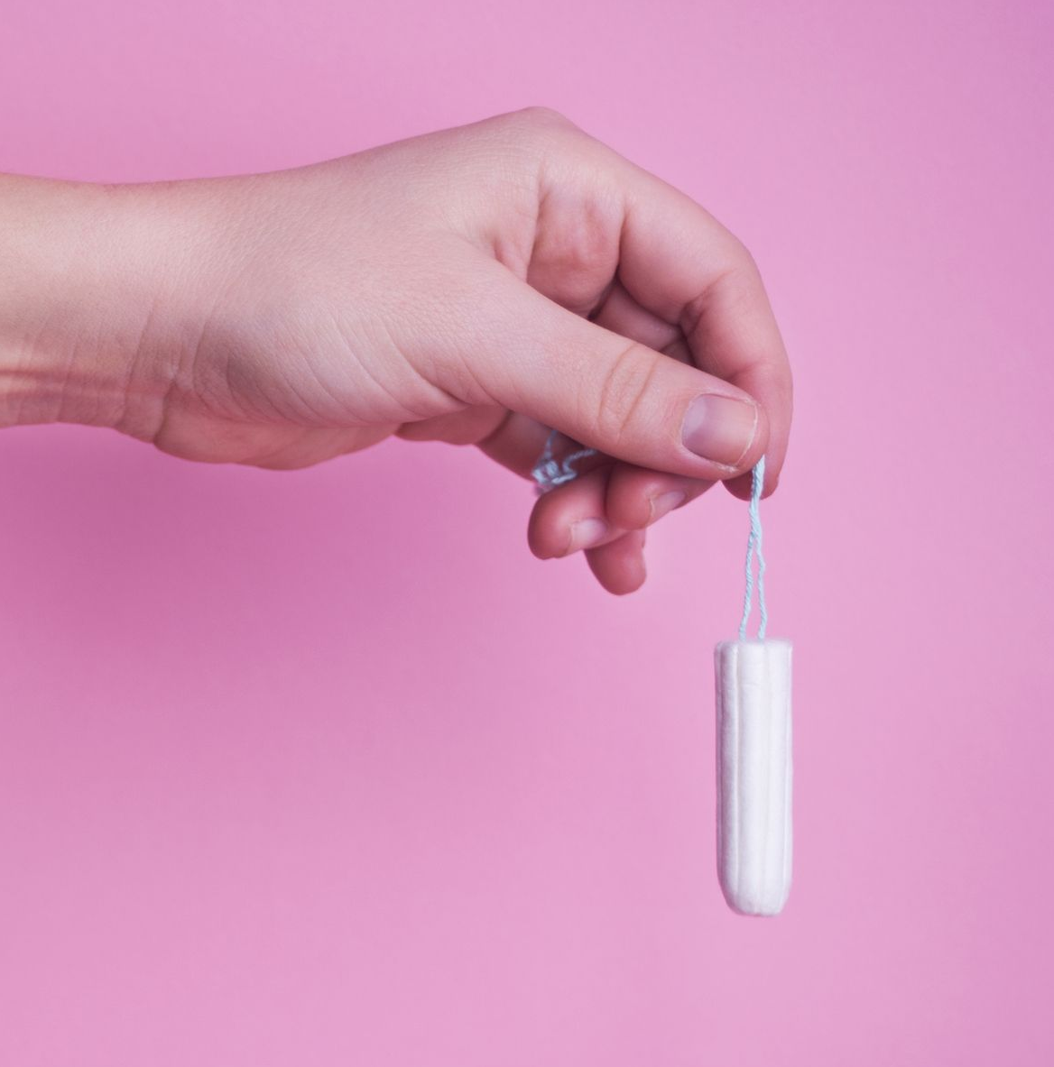
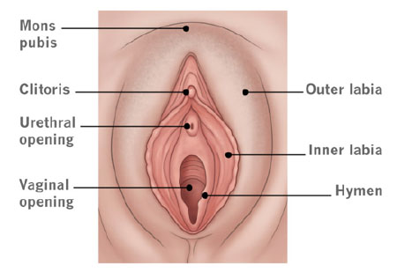
Key Information
Tampons
These are made of cotton and are put inside the vagina to absorb menstrual blood
Once inside, you should not be able to feel anything. It will expand slightly as it absorbs the liquid

Slide 40
Key Information
Tampons
They need to be changed regularly, depending on how heavy your period is (3-4 times a day)
It can be dangerous to your health to leave a tampon in for more than 8 hours. Always double check it has been removed at the end of your period

Slide 41
Key Information
Tampons
They take more practice to use than sanitary pads
The string hangs outside of the vaginal opening, so it can be easily pulled out when it needs changing
Don’t worry - they cannot get lost inside your vagina

Slide 42
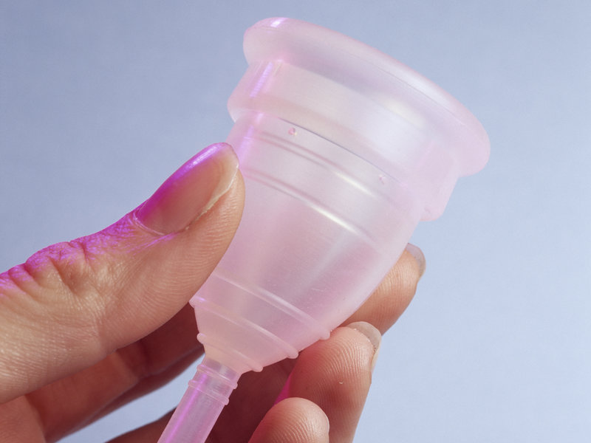
Key Information
Menstrual Cups
These are plastic cups, which are put inside the vagina to collect menstrual blood
They need to be emptied into a toilet and washed out regularly

Slide 43
Key Information
Menstrual Cups
They take more practice to use than sanitary pads
They are reusable, so do not create any waste and are cheaper in the long run

Slide 44
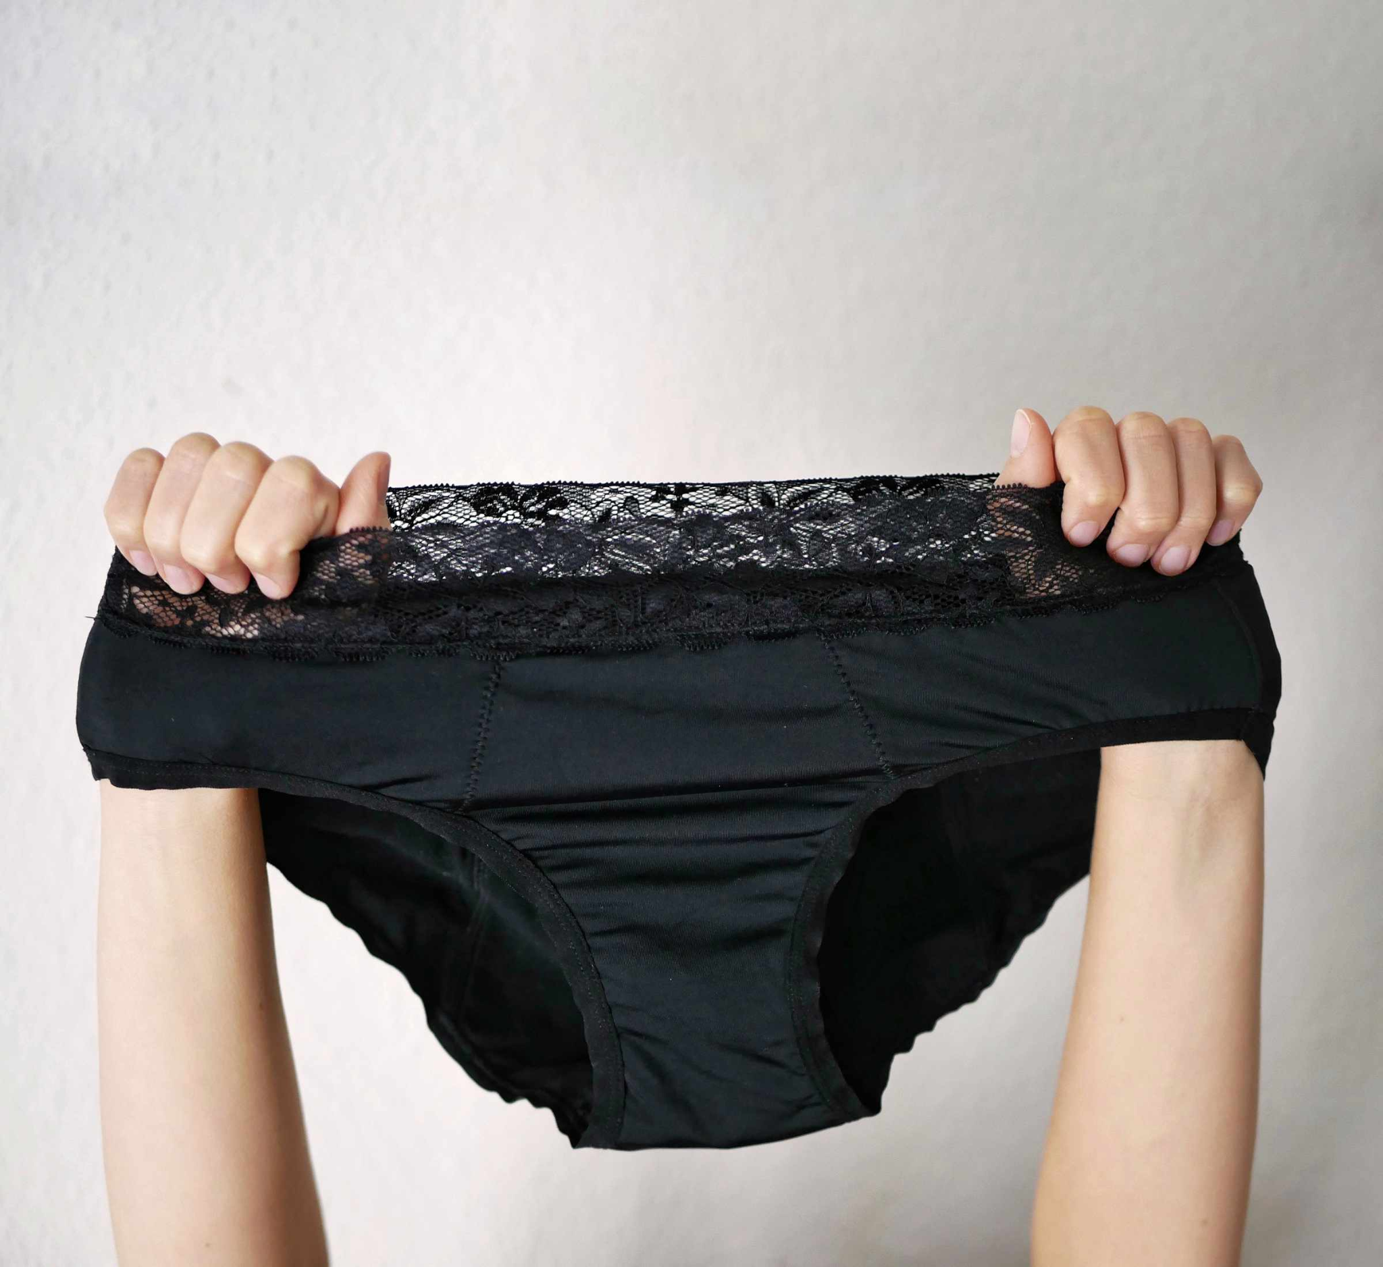
Key Information
Period pants
These are absorbent pants that can replace other menstrual products
They look very similar to regular pants and come in a range of styles

Slide 45
Key Information
Menstrual products
Although these are everyday products, the cost of them can cause difficulties for some people
Your school will probably have spare products if you need them
Please speak to a trusted adult if you need help finding or using them

Slide 46
Key Information
Menstrual products
None of these period management products prevent you from urinating (weeing) as the vagina and the urethral opening are in different places

Slide 47
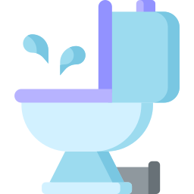
Key Information
Disposal
Never throw sanitary products into the toilet
They block the toilet very easily, as they don’t decompose

Slide 48
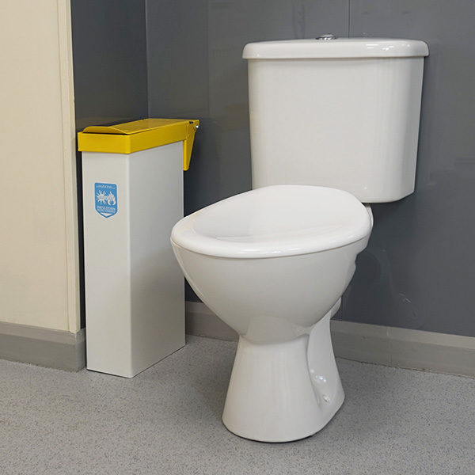
Key Information
Disposal
Use a sanitary bin where possible
If you use a normal bin, it’s probably better to wrap the product in a tissue first

Slide 49

Class discussion
Are periods seen as a
positive or negative thing?
Sadly, there is some shame and stigma around periods
However, many people around the world celebrate a menstruation first period and have parties or provide support to make the process more comfortable

Slide 50
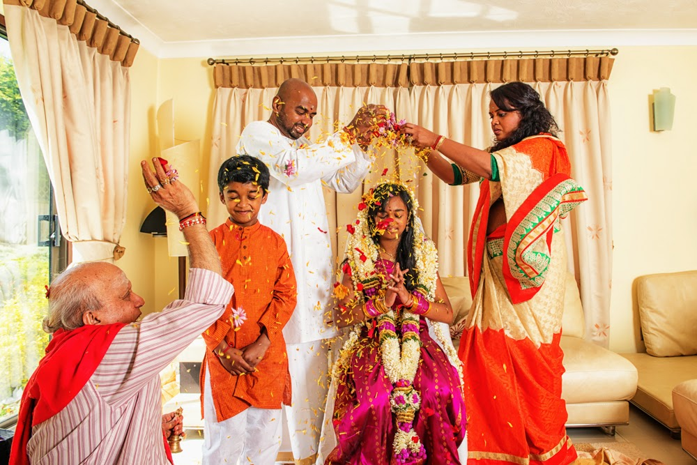
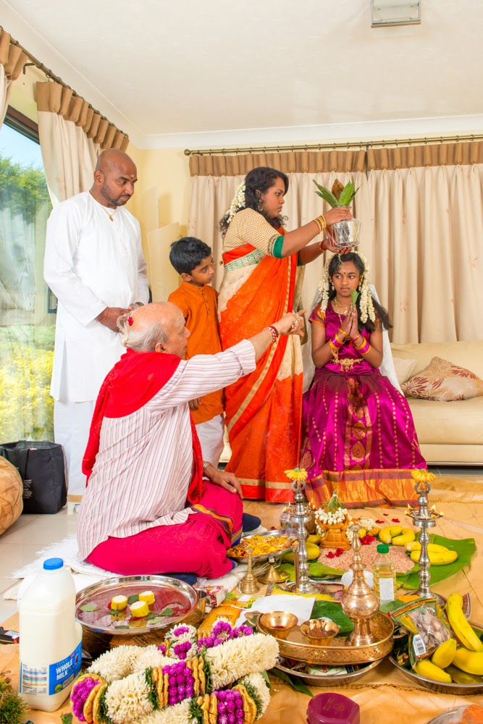
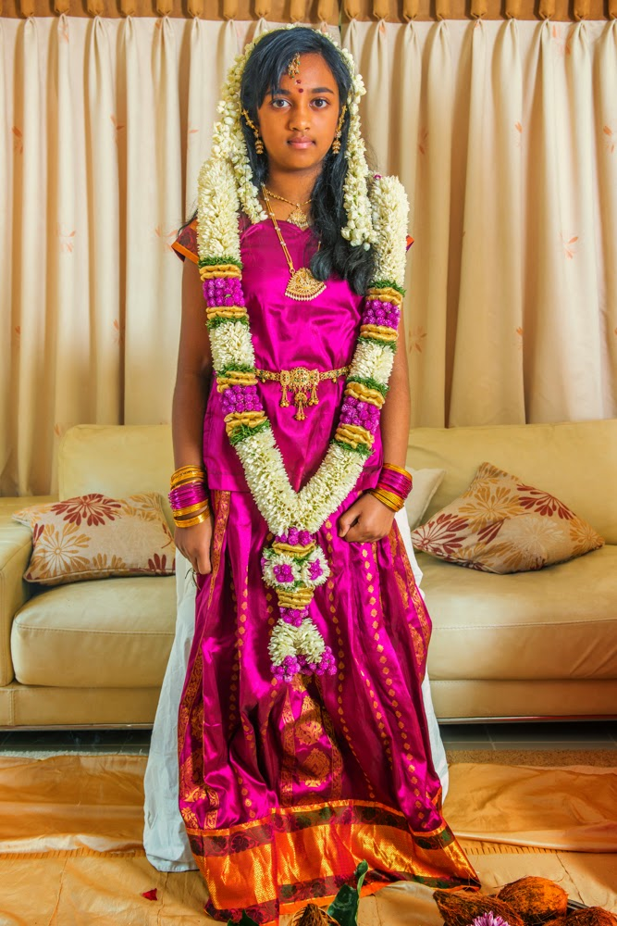

In some South Indian communities, a girl’s first period is welcomed through a coming-of-age ceremony.
This ceremony marks the transition of girls who have reached puberty and are now mature enough to understand their responsibilities.
http://davidwatsonoca.blogspot.com/p/assignment-5.html

Slide 51

In the United Kingdom, the government provides free menstrual products to Primary schools, for children who cannot afford them
Speak to an adult in school if you need support with your period

Slide 52

Class discussion
What support might menstruators
need during their period?

