Slide 1

Waverley approach to teaching phonics and early reading.

Slide 2
Why is Phonics Important?
There are lots of different strategies your child can use to help them read.
Memorising words
Using the pictures
Guessing
These strategies will only get your child so far.

Slide 3
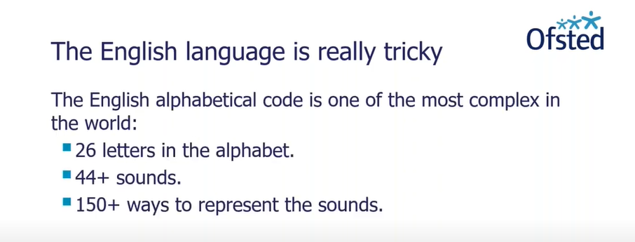
Why is Phonics Important?
https://www.youtube.com/watch?v=ZkzwAt-TPro

Slide 4
Beginner readers are taught four things.
The letters and the sounds they represent.
We use the pure sounds. We don’t say ‘muh’ we say mmmmm.
2. To blend sounds to make words.
This can start before your child recognises letters. You can do it orally. You can sound out everything and anything to them!
3. To segment words and say the sounds.
How many sounds in the world cat, frog etc.
4. Recognise and sight read a range of tricky words.

Slide 5
ACET Phonics Scheme.
It has been designed to consolidate phonics acquisition and promote fluency in early reading.
We will follow ACET phonics scheme which is based around Letters & Sounds.
It is Ofsted certified.
Letters and Sounds phases 1-5 have been divided into sub phases e.g. Phase 2a, Phase 2b up to Phase 5f. If your child is picking up phonics without any gaps they will be learning phase 4b by the end of the year.
Oxford Reading Tree books - The books sit behind the Letters and Sounds framework and are also in sub phases.
Once the child is a phase 5F reader they will go on to Oxford Reading Tree orange banded books.
Children MUST have been taught all the sounds of the phase BEFORE they have that phase book.
e.g. Phase 2a books cannot be given out until ALL Phase 2a has been taught.

Slide 6
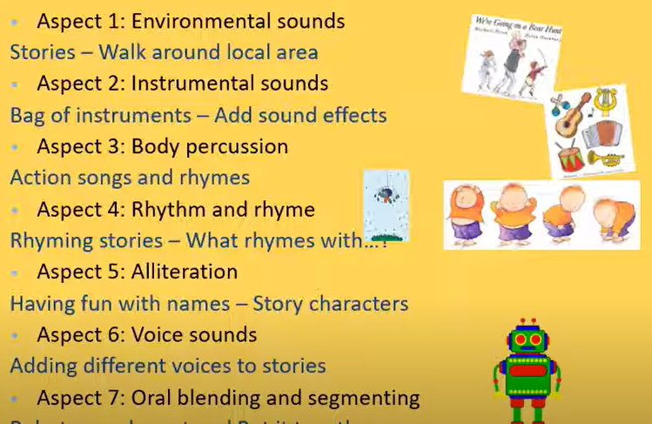
What your child should know before they start FS2.
Phase 1
Phase 1 is all about listening.
Listening to sounds in the environment, what sounds can children hear.
Listening and joining in nursery rhymes.
Developing vocabulary and language comprehension.
Oral blending.

Slide 7
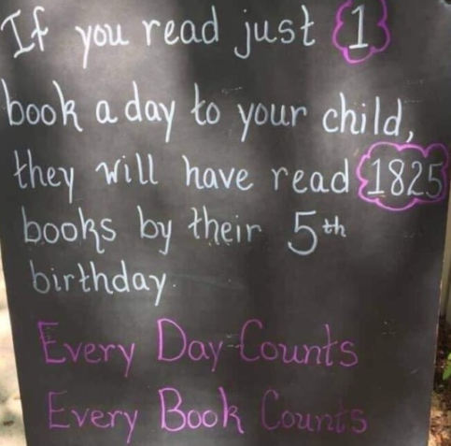
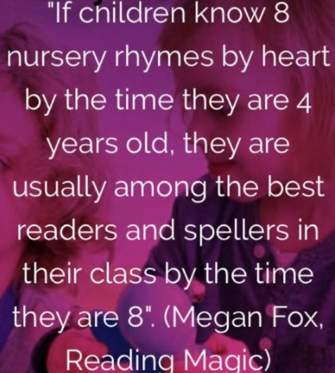

Slide 8
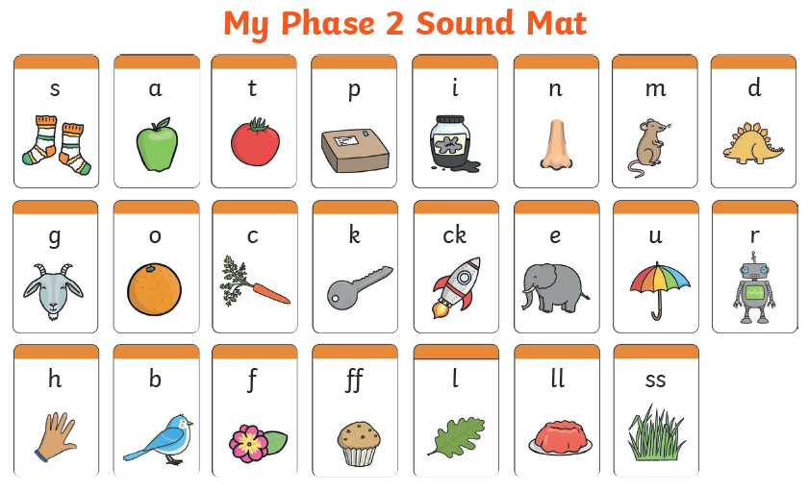
Phase 2 – FS2
Sounds of the phase 2 letters
Initial sounds
Oral blending and segmenting
Blending to read
Segmenting to spell – phonics fingers
Begin to read tricky words by sight
Begin to read HF words by sight
All this is BEFORE they get a reading book!
So at this point they will be taking home a Phase 1 book (lilac books with no words)

Slide 9
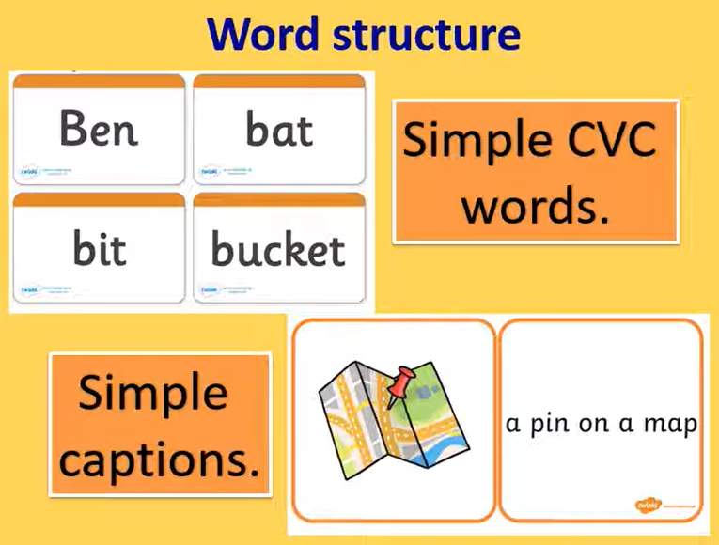
rock

Slide 10
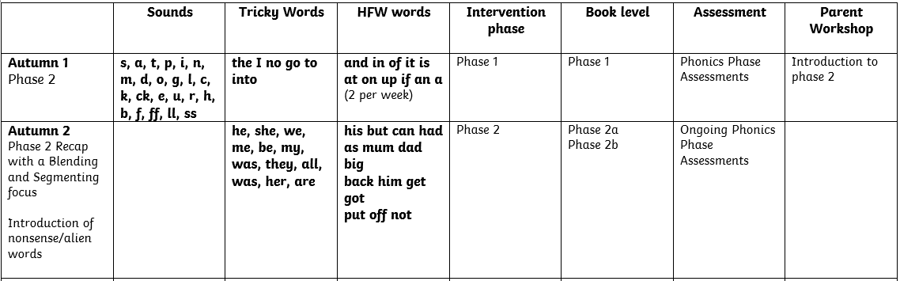
Phase 2 – FS2
2a) s, a, t, p, i, n, m, d, o, g, l,
2b) c, k, ck, e, u, r, h, b, f, ff, ll, ss

Slide 11
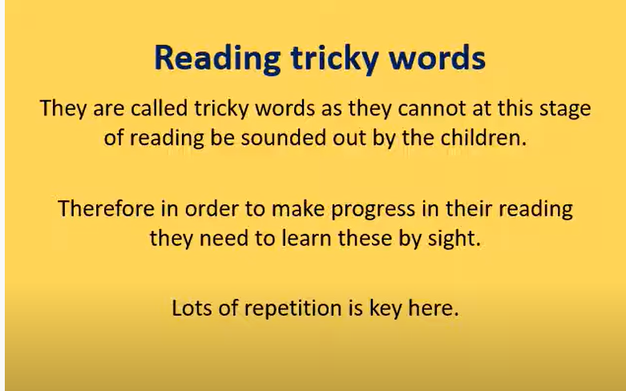
Tricky word hunts
Flash cards before dinner
Snap
Put them on the stairs
Bingo

Slide 12
High Frequency Words
Words that are really common in the first books your child will read.
Different from tricky words as they can be sounded out.
For fluency purposes we learn to sight read them.
A couple of examples:
it is in on

Slide 13
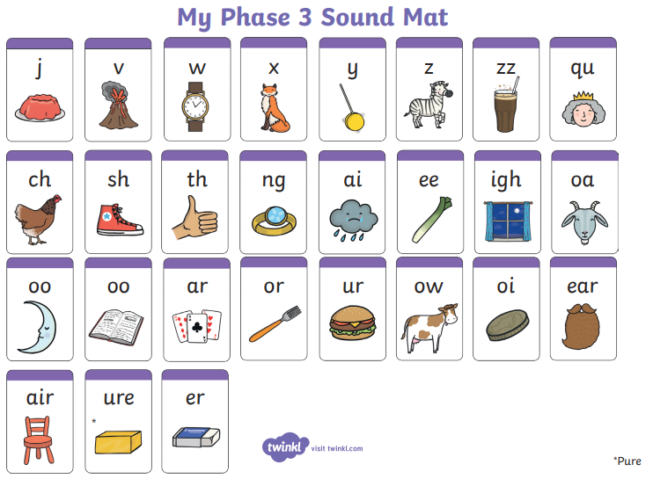
Phase 3 – FS2
For the majority of children phase 3 begins after Christmas.
j, v, w, x, y, z, DIGRAPHS, TRIGRAPHS
New Tricky words
New High Frequency words
Blending to read
Segmenting to spell
At this point they will be taking home a Phase 2 book and moving on to 3a, b, c, d as they learn the sounds

Slide 14
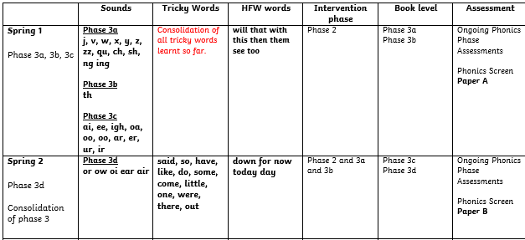
Phase 3 – FS2

Slide 15




Phase 3 – FS2
chip sheep night jail hear

Slide 16
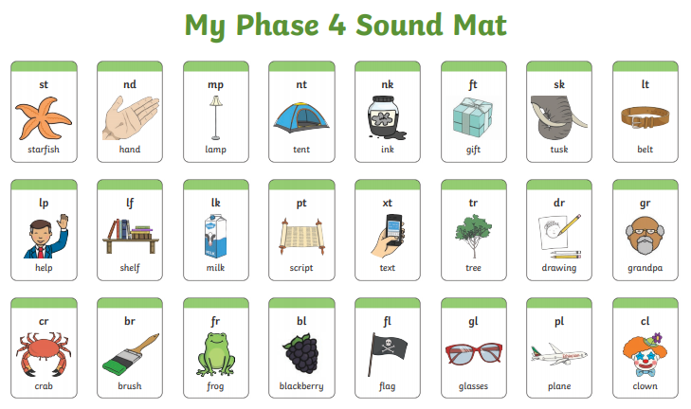
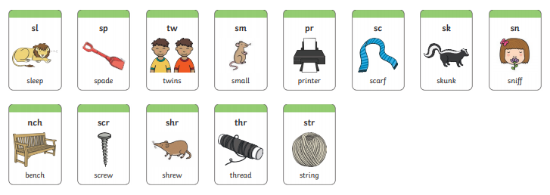
Phase 4 – FS2
Clusters/ blends
New Tricky words
New High Frequency words
Blending to read
Segmenting to spell
At this point they will be taking home a Phase 3d book and moving on to 4a and b as they learn the clusters

Slide 17
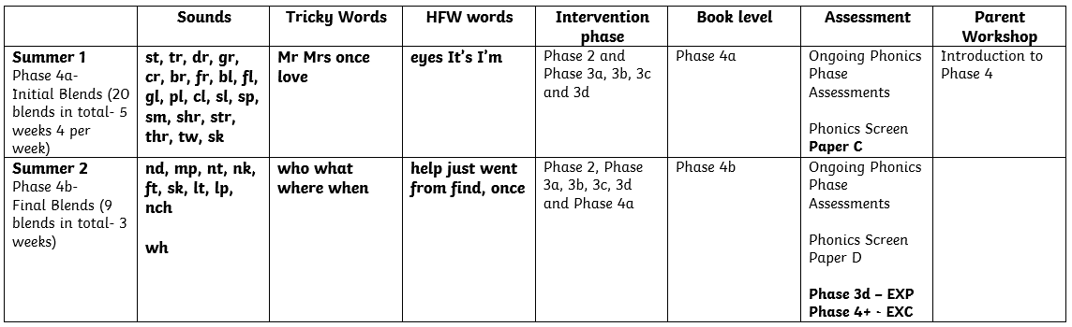
Phase 4 – FS2
lamp drop glad whisk drink smart
bench green

Slide 18
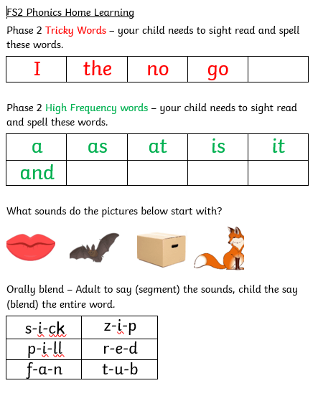
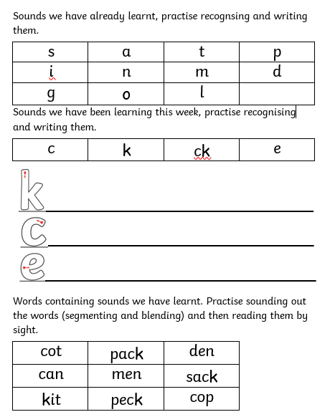
Phonics Home Learning

Slide 19
What Should My Child Know Now?
The letter sounds we have covered so far
s, a, t, p, i, n, m, d, g, o, l, c, k, ck, e
The tricky words we have covered so far
I, the, no, go
The high frequency words we gave covered so far
a, as, it, is
Should be able to orally blend and beginning to segment and read words using the letter sounds we have covered so far.

Slide 20
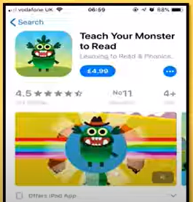
What else can I do at home to support my child?
https://www.phonicsplay.co.uk/resources
https://www.phonicsbloom.com/
Teach Your Monster to Read

Slide 21
FS2
Phase 2- s a t p i n m d g o l/ c k ck e u r h b f ff ll ss
Phase 3- zz qu ch sh ng ing/ th/ ai ee igh oa oo oo er ur ir/ or ow oi ear air
Phase 4- st tr dr gr cr br fr bl fl gl pl cl sl sp sm shr str thr tw sk/ nd mp nt nk ft sk lt lp nch wh
Tricky words
Phase 2- I no go to the into/ he she we me be my way they all her are you
Phase 3- said so do have like some come little one were there out
Phase 4- Mr Mrs love/who what where when
High Frequency
Phase 2- and in of it is at on up if an a his/but can had as mum dad big back him get got put off not
Phase 3- will that with this then them see too/ down for now today day
Phase 4- eyes it’s I’m/ help just wet from find once

Slide 22

Taking books home
One phonics book and one reading for pleasure book per week!
(children will be reading and re reading texts to become fluent readers)
All books are collected in on Friday.
Phonics reading books are given out every Friday. These are the books for your child to read to you.
(children will be reading and re reading texts to become fluent readers)
Reading for pleasure books (library books) are given out every Friday. Reading for pleasure book - for parents to read to children, this will be explained it is only for this purpose, not for the child to read independently
New books will not be given out until the previous set are returned.
Oxford reading tree website.
https://home.oxfordowl.co.uk/reading/reading-at-home/

Slide 23
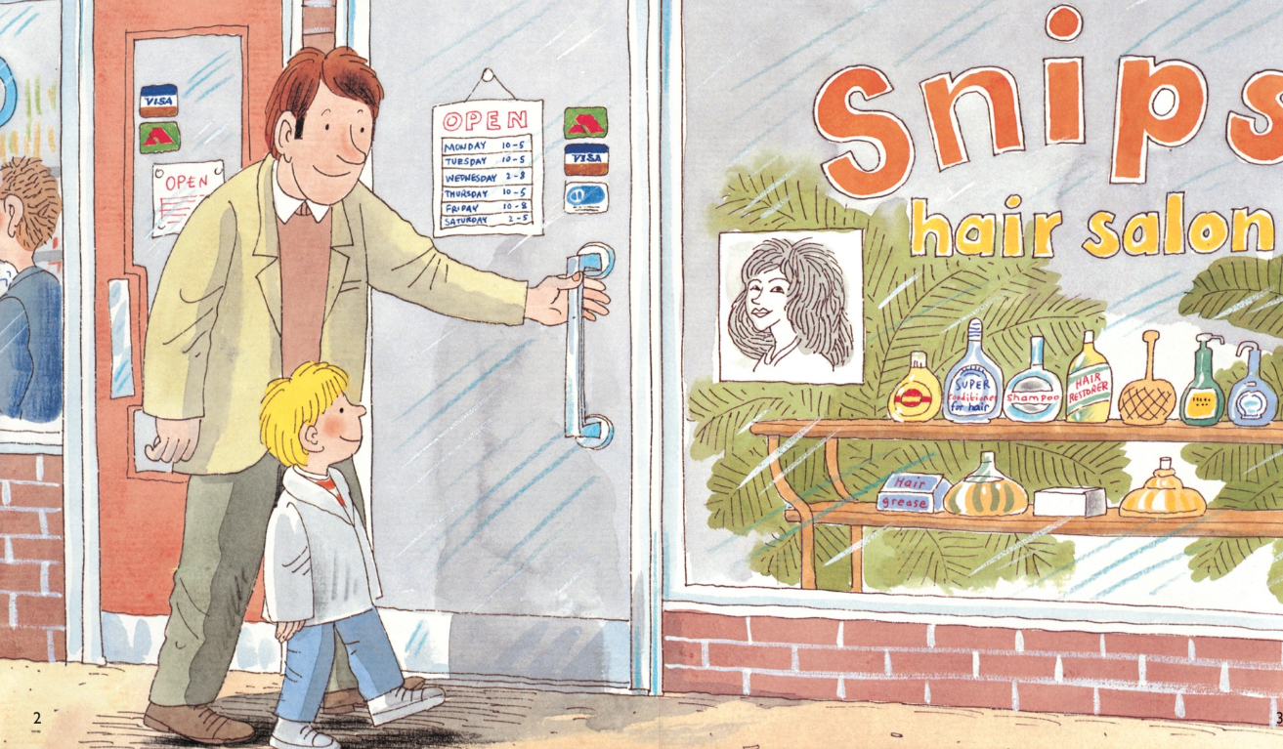
If a book has no words in it.
Phase 1 books are wordless books that tell a story through pictures alone. They help children to develop speaking and listening skills through creating and telling stories.
Your child is just beginning to discover the excitement of books.
Although these books have no words, they are an important introduction to reading.
Please encourage your child to:
Look at the pages in order, and talk about what is happening on the left hand page before the right hand page.
Talk about what is happening on each page, rather than just talking about what they see in each picture.
Tell you who or what the story is about.
Discuss the characters in the story and how they
might be feeling at certain points.

Slide 24
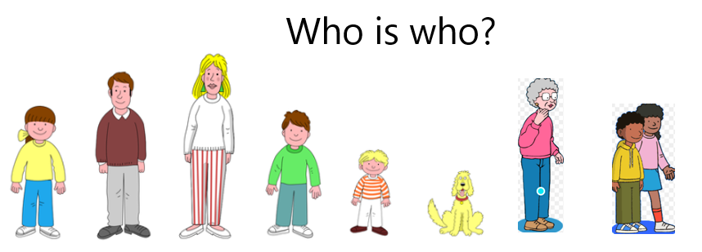
Mum
Dad
Gran
Biff
Wilf and Wilma
Chip
Kipper
Floppy
Children will need to know the character’s names and be able to recognise them in order to access some phase 2 books.

Slide 25
Questions you can ask your child as they read.
Can you find the title of the book? What does it say?
I wonder what this book will be about? What do you think?
Where do we start to read?
Can you see any words you know on this page?
What sound does this word begin with?
Did that sound right? Try again.
What do you think might happen next?
Can you tell me what has happened in the story? Beginning, middle and end.
Who are the characters in the story?

Slide 26
Accuracy, fluency and Comprehension
Accuracy – All books are 100% decodable (and/or children have been taught the tricky words at that level)
Fluency – Children should read and repeat, so they are fluent before moving on to the next book or level.
Comprehension – taught through guided reading, whole class teaching throughout the curriculum, key reading skills and whole class texts.

Slide 27
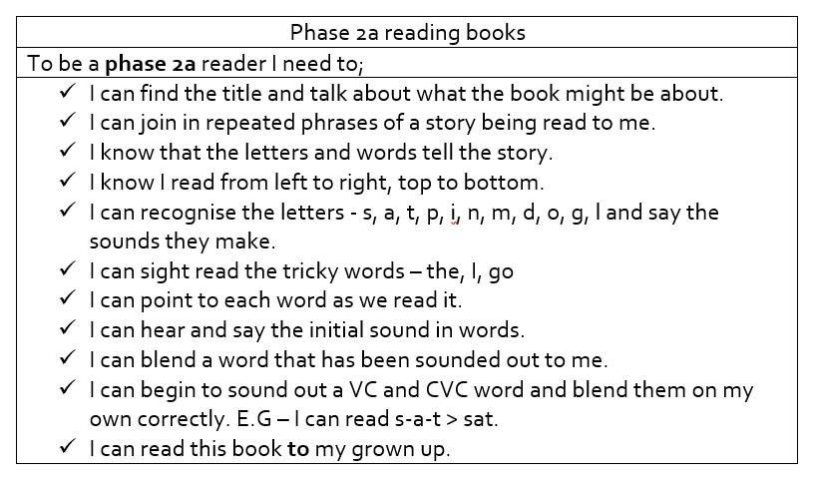

Book Band Expectations
Phase Book Banding has been split to make small milestones for the children to achieve.
Expectations are in planners, so you can see what your child needs to achieve to move up to the next reading level.

Slide 28
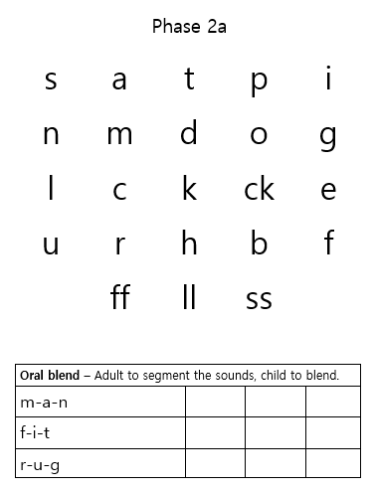
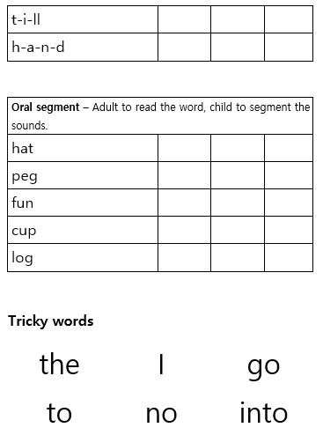
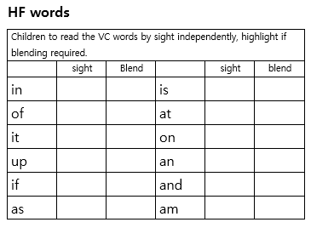
Tracking and Assessment

Slide 29

Any Questions?

